Slide 1

AMRUTVAHINI COLLEGE OF ENGINEERING,
SANGAMNER
DEPARTMENT OF COMPUTER ENGINEERING
2024-2025
Presentation
On
“BlockShare - Blockchain Based Secure Data Sharing Platform”
BE Computer Engineering
BY
Group Id: B-06
Mr. Abhijit Rajaram Sahane (4228)
Mr. Shinde Rohit Nivrutti (4240)
Mr. Sayyad Mohammadsaani Shahid (4234)
Mr. Kankate Sairaj Chandrakant (4157)
Guided by: Project Coordinator: H.O.D
Ms. K. U. Rahane Dr. D. R. Patil Dr. S. K. Sonkar

Slide 2
Process Model

Slide 3
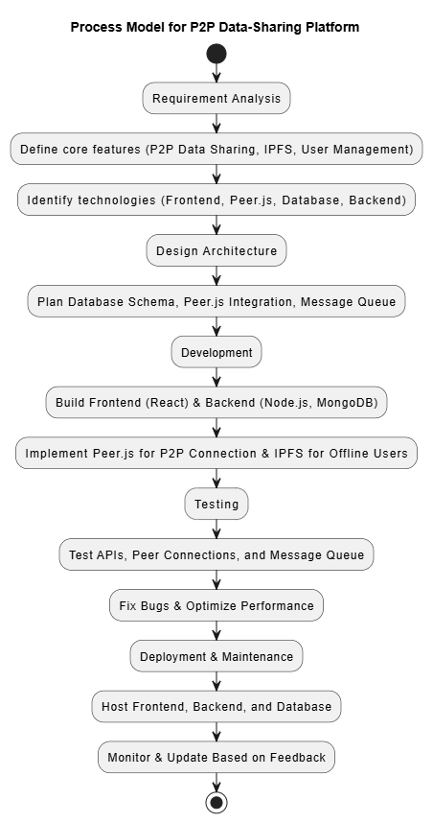

Slide 4
Architectural model

Slide 5
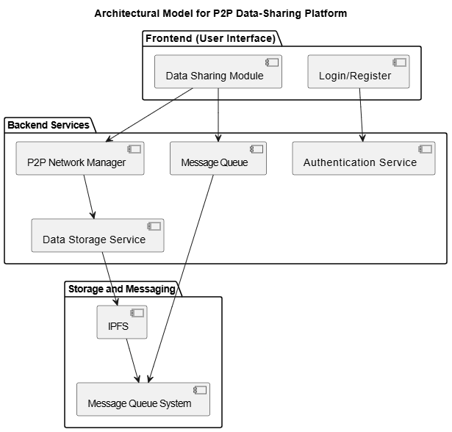

Slide 6
Component Diagram

Slide 7
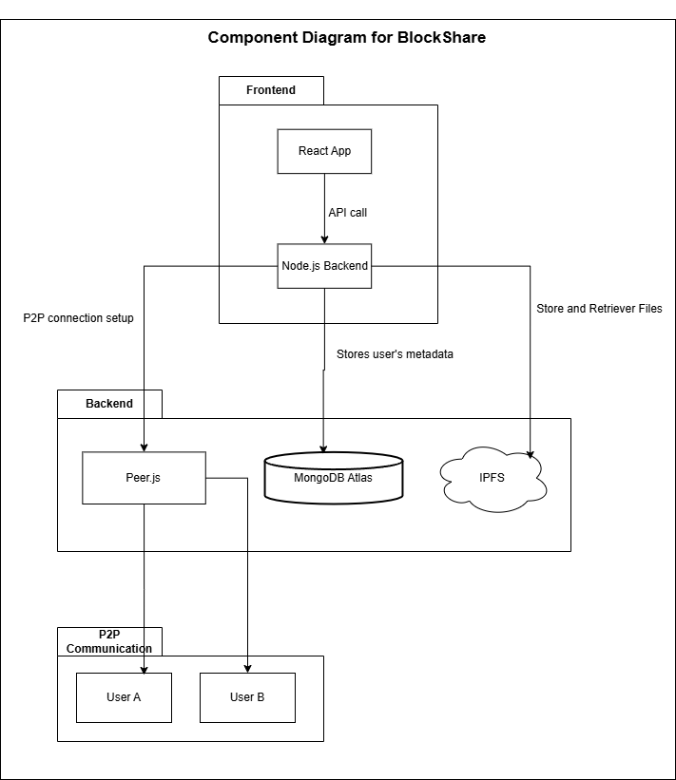

Slide 8
Deployment Diagram

Slide 9
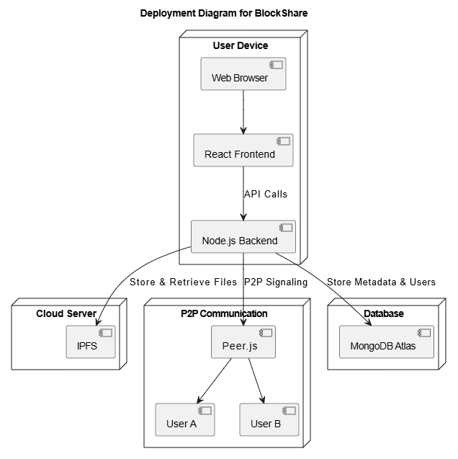

Slide 10
Deployment Diagram

Slide 11
NP-Completeness Analysis
The system consists of different computational steps, some of which are polynomial-time while others may involve NP-complete and NP-hard subproblems.
Polynomial-Time Components
Efficient Computations in BlockShare:
File Upload & Retrieval (IPFS-based content addressing) → O(1)
Peer Discovery (libP2P DHT-based lookup) → O(log N)
Metadata Storage & Retrieval (MongoDB Atlas queries) → O(n)
NP-Hard and NP-Complete Subproblems
Optimized Offline Message Delivery Job Scheduling Problem(NP-hard)
If multiple senders queue messages for offline users, finding the best delivery order while avoiding bottlenecks becomes computationally complex.
Efficient File Retrieval from Multiple IPFS Peers (NP-complete)
When file chunks are stored across multiple peers, selecting the minimum number of nodes to reconstruct a file is combinatorially hard.

Slide 12
Thank You

